Slide 1
Lecture 5
Petri Nets
These slides are Based on Lecture notes from:
Dr. Chris Ling (http://www.csse.monash.edu.au/~sling/)

Slide 2
Topics
Petri nets
Examples:
POS Terminal
Vending Machine
Restaurant
Producer Consumer
Petri net structures
Petri net properties:
Liveness
Boundedness
Reachability

Slide 3
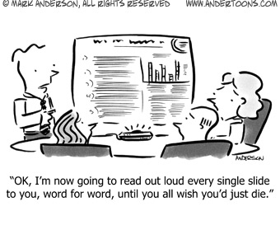
Ok, let’s start…

Slide 4
Introduction
First introduced by Carl Adam Petri in 1962.
A diagrammatic tool to model concurrency and synchronization in systems
They allow us to quickly simulate complex concurrent behavior (which is faster than prototyping!)
Fairly similar to UML State machines that we have seen so far
Used as a visual communication aid to model the system behavior
Based on strong mathematical foundation

Slide 5
Example: POS Terminal (UML State Machine)
(POS= Point of Sale)
idle
1 digit
d1
1 digit
d2
1 digit
1 digit
d3
d4
OK
OK
OK
OK
OK
pressed
Rejected
Reject
approve
Approved

Slide 6
Example: POS Terminal (Petri Net)
1 digit
1 digit
1 digit
1 digit
d4
Initial
d1
d2
d3
OK
OK
OK
OK
OK
pressed
Rejected!
Reject
approve
approved

Slide 7
POS Terminal
Scenario 1: Normal
Enters all 4 digits and press OK.
Scenario 2: Exceptional
Enters only 3 digits and press OK.

Slide 8
Example: POS System (Token Games)
1 digit
1 digit
1 digit
1 digit
d4
Initial
d1
d2
d3
OK
OK
OK
OK
OK
pressed
Rejected!
Reject
approve
approved

Slide 9
A Petri Net Components
The terms are bit different than UML state machines
Petri nets consist of three types of components: places (circles), transitions (rectangles) and arcs (arrows):
Places represent possible states of the system
Transitions are events or actions which cause the change of state (be careful, transitions are no longer arrows here)
Every arc simply connects a place with a transition or a transition with a place.

Slide 10
Change of State
A change of state is denoted by a movement of token(s) (black dots) from place(s) to place(s)
Is caused by the firing of a transition.
The firing represents an occurrence of the event or an action taken
The firing is subject to the input conditions, denoted by token availability

Slide 11
Change of State
A transition is firable or enabled when there are sufficient tokens in its input places.
After firing, tokens will be transferred from the input places (old state) to the output places, denoting the new state

Slide 12
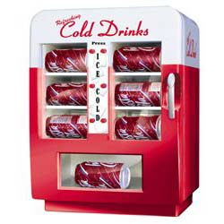
Example: Vending Machine
The machine dispenses two kinds of snack bars – 20c and 15c
Only two types of coins can be used
10c coins and 5c coins (ah the old days!!)
The machine does not return any change

Slide 13
Example: Vending Machine (UML State Machine)
Take 15c snack bar
5 cents
inserted
Deposit 10c
15 cents
inserted
Deposit 5c
0 cent
inserted
Deposit 5c
Deposit 5c
Deposit 5c
Deposit 10c
10 cents
inserted
Deposit 10c
20 cents
inserted
Take 20c snack bar

Slide 14
Example: Vending Machine (A Petri net)
Take 15c bar
Deposit 10c
15c
5c
Deposit 5c
Deposit 5c
Deposit
5c
0c
Deposit
5c
Deposit 10c
10c
20c
Deposit 10c
Take 20c bar

Slide 15
Example: Vending Machine (3 Scenarios)
Scenario 1:
Deposit 5c, deposit 5c, deposit 5c, deposit 5c, take 20c snack bar.
Scenario 2:
Deposit 10c, deposit 5c, take 15c snack bar.
Scenario 3:
Deposit 5c, deposit 10c, deposit 5c, take 20c snack bar.

Slide 16
Example: Vending Machine (Token Games)
Take 15c bar
Deposit 10c
15c
5c
Deposit 5c
Deposit 5c
Deposit
5c
0c
Deposit
5c
Deposit 10c
10c
20c
Deposit 10c
Take 20c bar

Slide 17
Multiple Local States
In the real world, events happen at the same time
A system may have many local states to form a global state.
There is a need to model concurrency and synchronization

Slide 18
Example: In a Restaurant (A Petri Net)
Waiter
free
Customer 1
Customer 2
Take
order
Take
order
wait
Order
taken
wait
eating
eating
Tell
kitchen
Serve food
Serve food

Slide 19
Example: In a Restaurant (Two Scenarios)
Scenario 1:
Waiter
Takes order from customer 1
Serves customer 1
Takes order from customer 2
Serves customer 2
Scenario 2:
Waiter
Takes order from customer 1
Takes order from customer 2
Serves customer 2
Serves customer 1

Slide 20
Example: In a Restaurant (Scenario 2)
Waiter
free
Customer 1
Customer 2
Take
order
Take
order
wait
Order
taken
wait
eating
eating
Tell
kitchen
Serve food
Serve food

Slide 21
Example: In a Restaurant (Scenario 1)
Waiter
free
Customer 1
Customer 2
Take
order
Take
order
wait
Order
taken
wait
eating
eating
Tell
kitchen
Serve food
Serve food

Slide 22
Net Structures
A sequence of events/actions:
Concurrent executions:
e1
e2
e3
e2
e3
e1
e4
e5

Slide 23
Net Structures
Non-deterministic events - conflict, choice or decision: A choice of either e1, e2 … or e3, e4 ...
e1
e2
e3
e4

Slide 24
Net Structures
Synchronization
e1

Slide 25
Net Structures
Synchronization and Concurrency
e1

Slide 26
Another Example
A producer-consumer system, consist of:
One producer
Two consumers
One storage buffer
With the following conditions:
The storage buffer may contain at most 5 items;
The producer sends 3 items in each production;
At most one consumer is able to access the storage buffer at one time;
Each consumer removes two items when accessing the storage buffer

Slide 27
A Producer-Consumer System
k=1
k=2
ready
accepted
p1
p4
Storage p3
produce
accept
3
2
t1
t2
t3
t4
consume
send
k=5
p2
p5
idle
ready
k=1
k=2
Producer
Consumers

Slide 28
A Producer-Consumer Example
In this Petri net, every place has a capacity and every arc has a weight.
This allows multiple tokens to reside in a place to model more complex behavior.

Slide 29
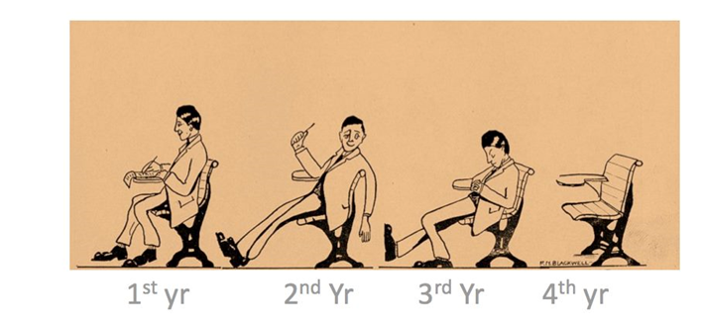
Short Break?
Lives and Times of Engineering Students
Are you here yet?

Slide 30
Behavioral Properties
Reachability
“Can we reach one particular state from another?”
Boundedness
“Will a storage place overflow?”
Liveness
“Will the system die in a particular state?”

Slide 31
Recalling the Vending Machine (Token Game)
Take 15c bar
Deposit 10c
15c
5c
Deposit 5c
Deposit 5c
Deposit
5c
0c
Deposit
5c
Deposit 10c
10c
20c
Deposit 10c
Take 20c bar

Slide 32
A marking is a state ...
t8
p4
M0 = (1,0,0,0,0)
t4
p2
M1 = (0,1,0,0,0)
t1
M2 = (0,0,1,0,0)
M3 = (0,0,0,1,0)
p1
M4 = (0,0,0,0,1)
t3
t5
t7
Initial marking:M0
t6
p5
t2
p3
t9

Slide 33
Reachability
t8
p4
t4
M0 = (1,0,0,0,0)
p2
t1
M1 = (0,1,0,0,0)
M2 = (0,0,1,0,0)
p1
M3 = (0,0,0,1,0)
t3
t5
t7
M4 = (0,0,0,0,1)
p3
t6
p5
Initial marking:M0
t2
t9
M0
t1
t3
t5
t8
t2
t6
M1
M2
M3
M0
M2
M4

Slide 34
Reachability
“M2 is reachable from M1 and M4 is reachable from M0.”
In fact, in the vending machine example, all markings are reachable from every marking.
A firing or occurrence sequence:
M0
t1
t3
t5
t8
t2
t6
M1
M2
M3
M0
M2
M4

Slide 35
Boundedness
A Petri net is said to be k-bounded or simply bounded if the number of tokens in each place does not exceed a finite number k for any marking reachable from M0.
The Petri net for vending machine is 1-bounded.

Slide 36
Liveness
A Petri net with initial marking M0 is live if, no matter what marking has been reached from M0, it is possible to ultimately fire any transition by progressing through some further firing sequence.
A live Petri net guarantees deadlock-free operation, no matter what firing sequence is chosen.

Slide 37
Liveness
The vending machine is live and the producer-consumer system is also live.
A transition is dead if it can never be fired in any firing sequence.

Slide 38
An Example
t1
p3
p1
p2
t3
t4
p4
t2
M0 = (1,0,0,1)
M1 = (0,1,0,1)
M2 = (0,0,1,0)
M3 = (0,0,0,1)
A bounded but non-live Petri net

Slide 39
Another Example
p1
M0 = (1, 0, 0, 0, 0)
M1 = (0, 1, 1, 0, 0)
t1
M2 = (0, 0, 0, 1, 1)
M3 = (1, 1, 0, 0, 0)
p2
p3
M4 = (0, 2, 1, 0, 0)
t2
t3
p4
p5
t4
An unbounded but live Petri net

Slide 40
Thank you!
Questions?

